Slide 1
Angular Reactive Forms
OVERVIEW

Slide 2
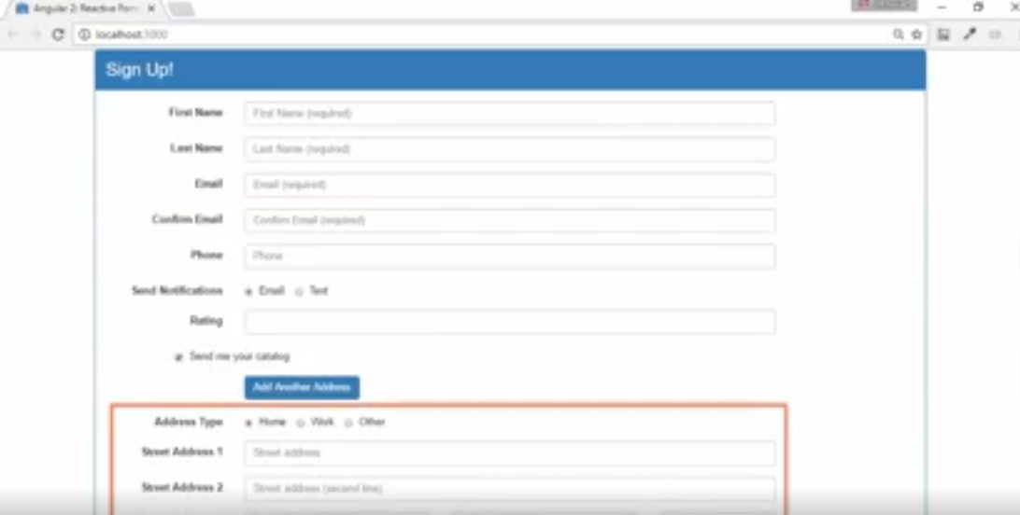

Slide 3
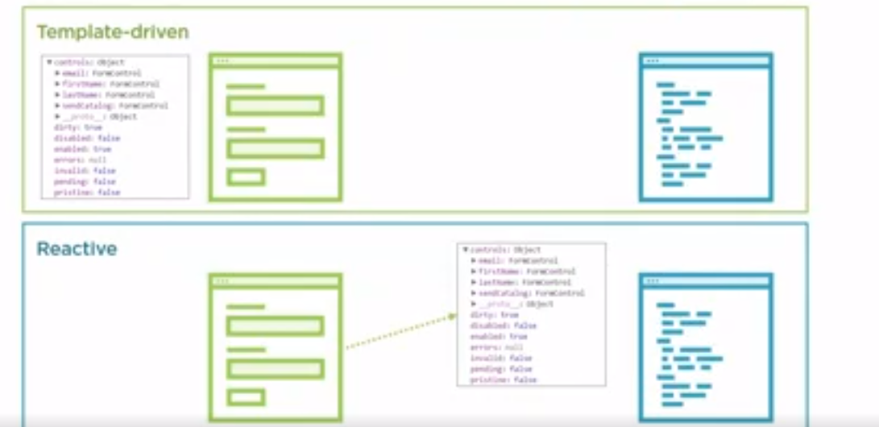

Slide 4
